Slide 1
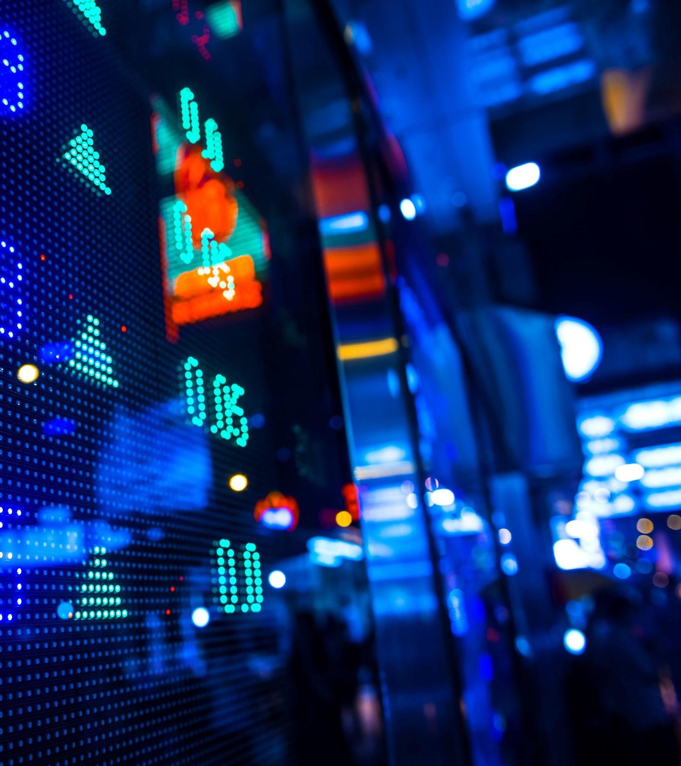
Investment Dashboard
How Will Your Money Grow?
Aalok Devkota
Gurcharan Singh
Heather Marshall
Stephanie Lin

Slide 2
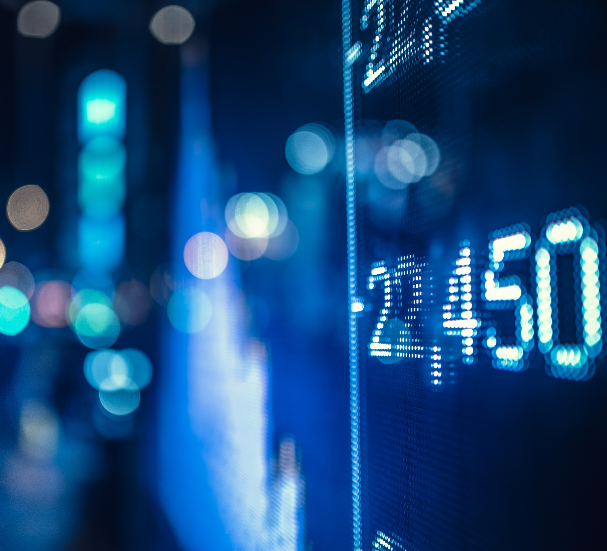
Project purpose
How to Invest:
Professional investment advisors are expensive – just ask Aalok
Dashboard will generate projected outcomes based on input
See How Your Money Grows:
Generate visualizations based on amount invested, time of investment, and portfolio type
Will You Achieve Your Goal?
Probability of success dependent on dollar invested and portfolio type

Slide 3
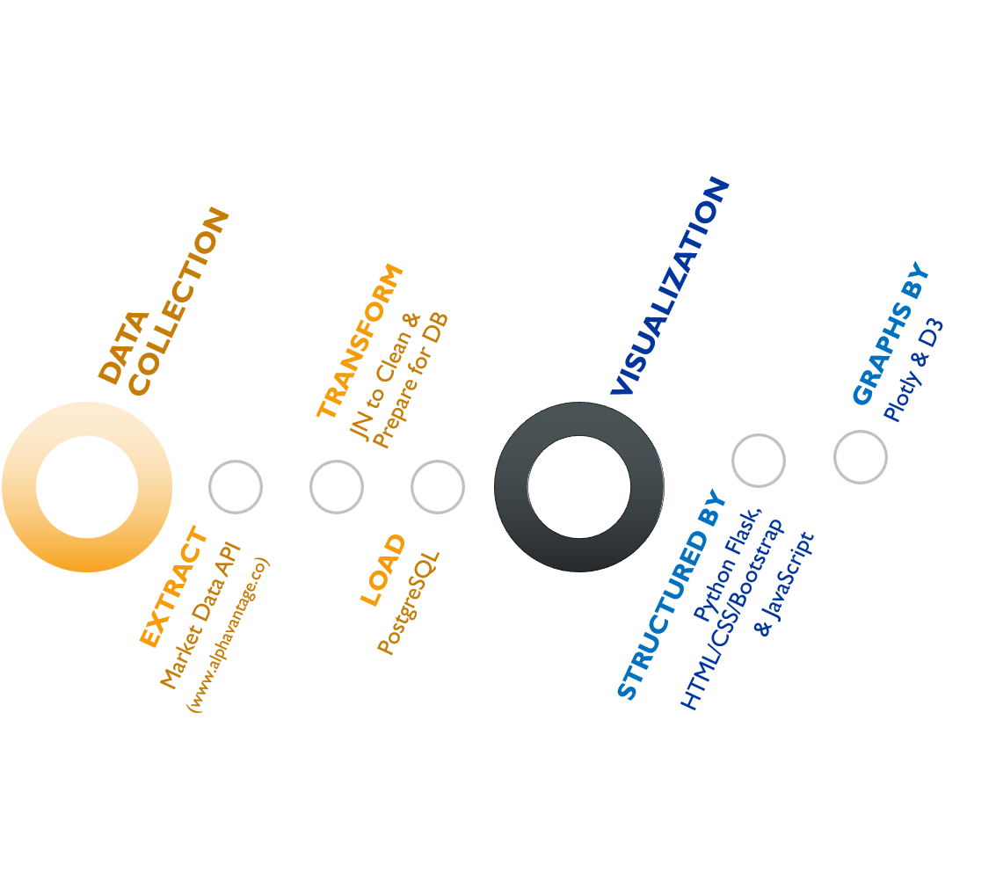
Work process

Slide 4
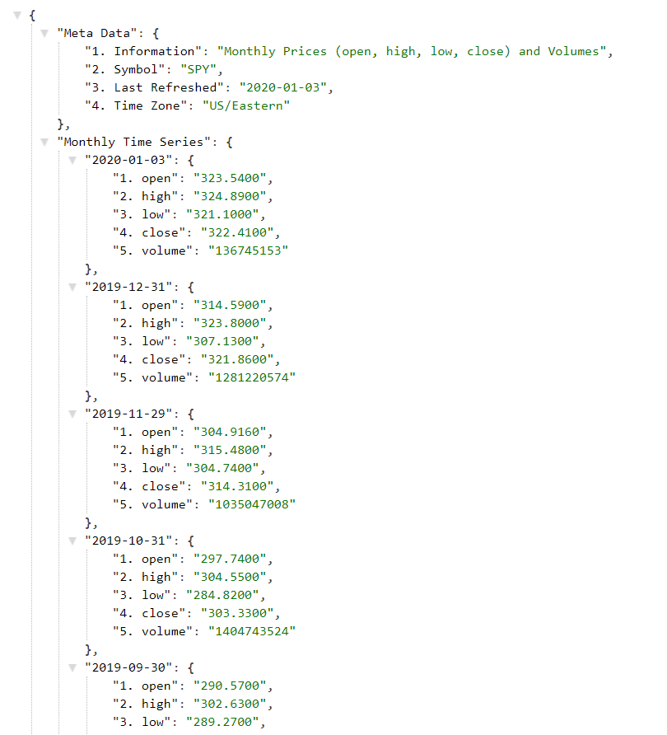
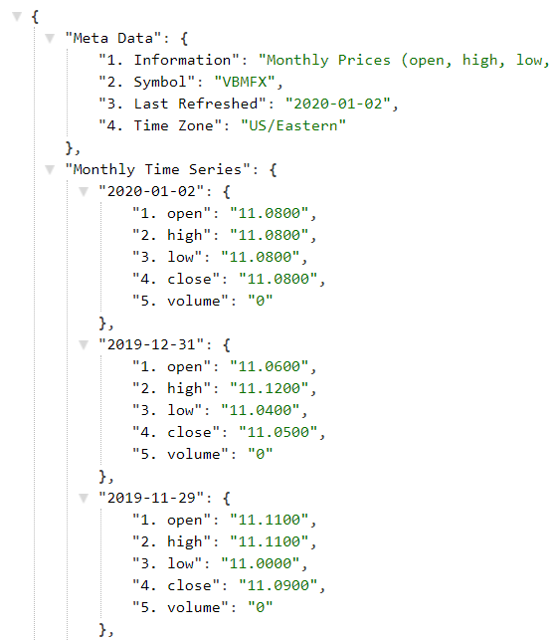
Meta data

Slide 5
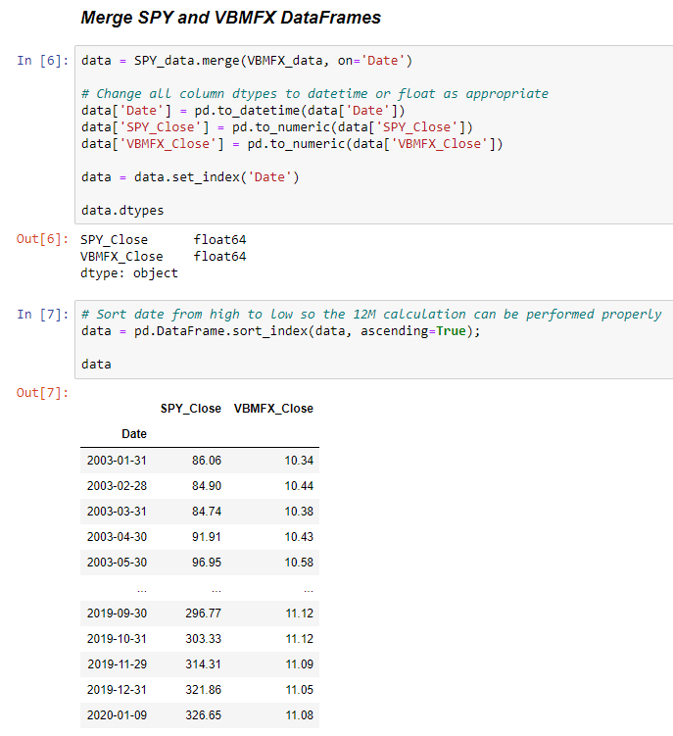
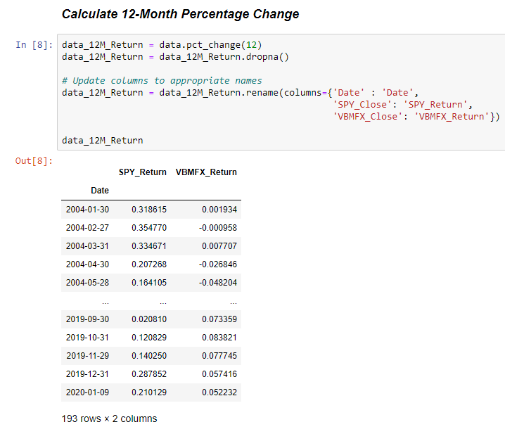
Extract

Slide 6
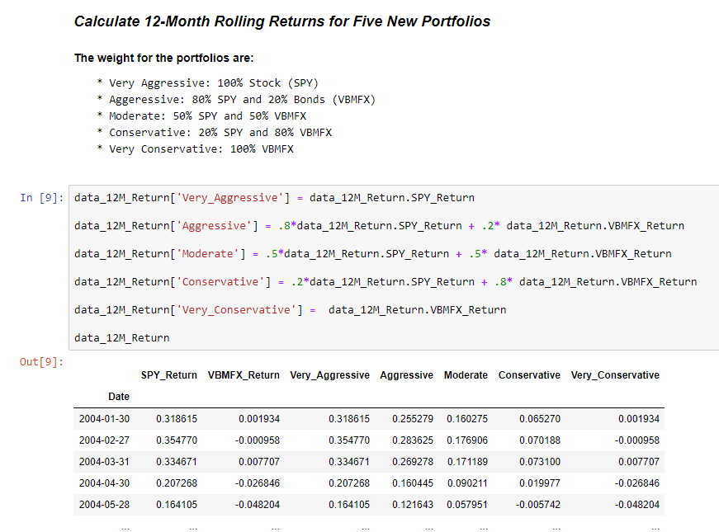
transform

Slide 7
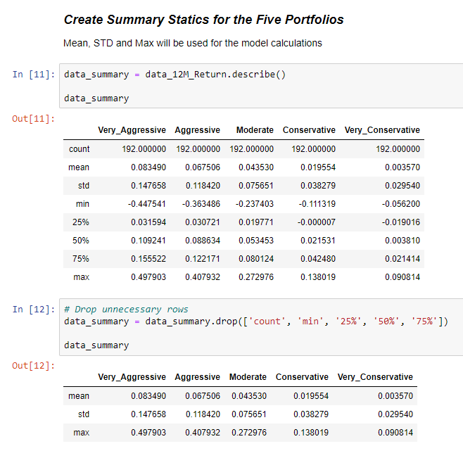
transform

Slide 8
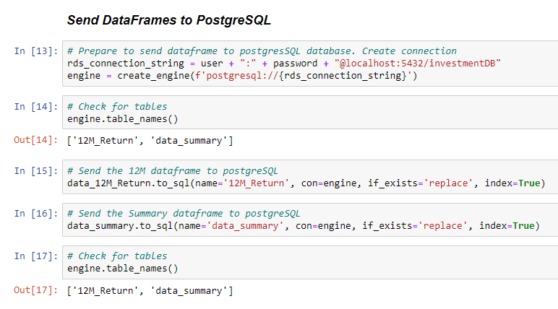
load

Slide 9
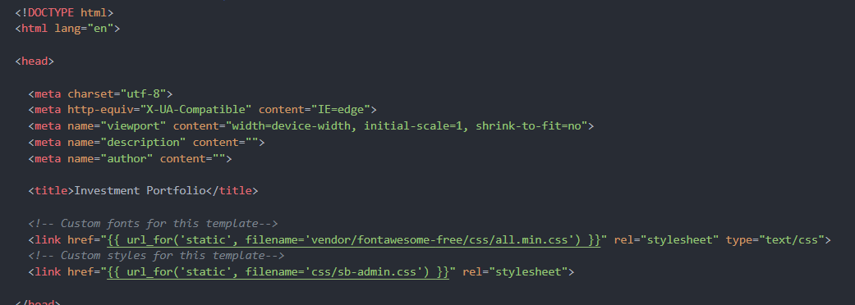
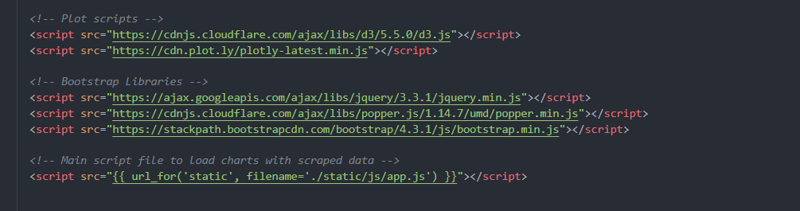
html

Slide 10
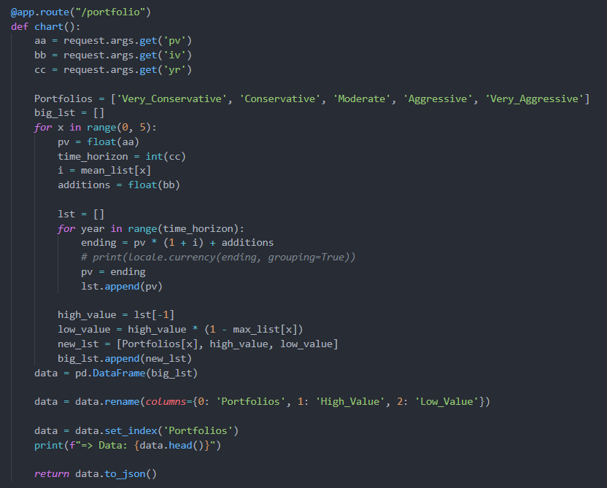
Flask app

Slide 11
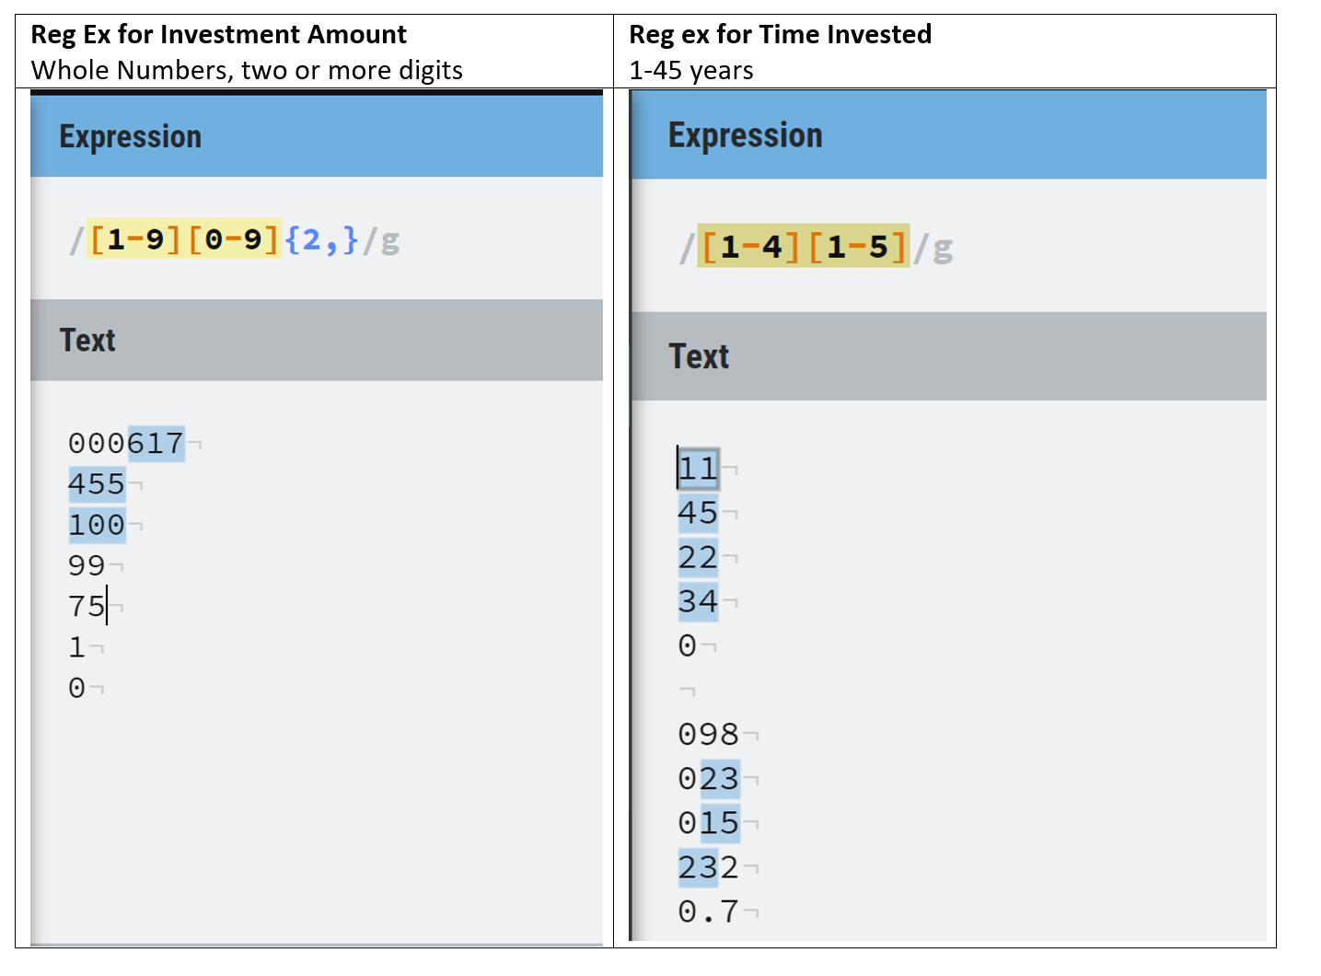
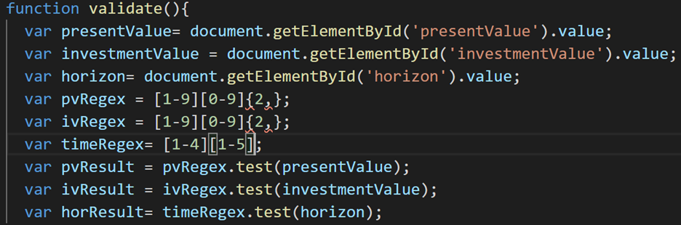
Form validation

Slide 12
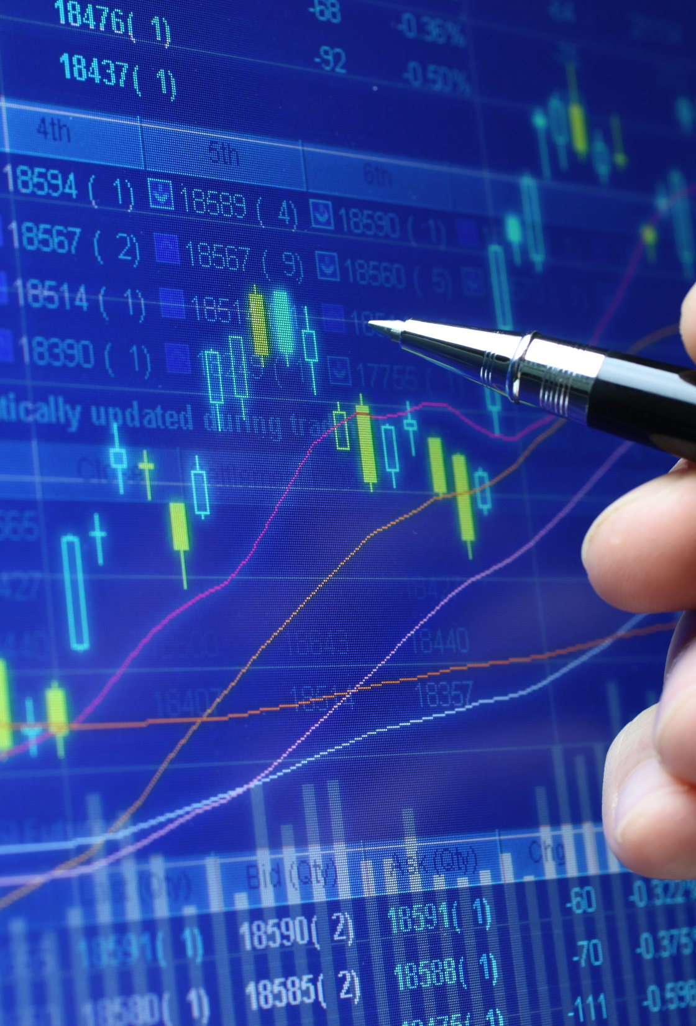
dashboard
All the components together creates this:
Investment Dashboard

